Slide 1
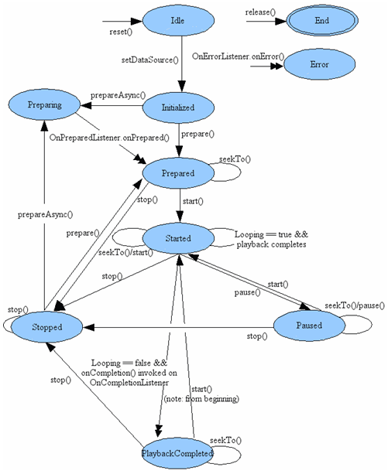
Video Player states

Slide 2
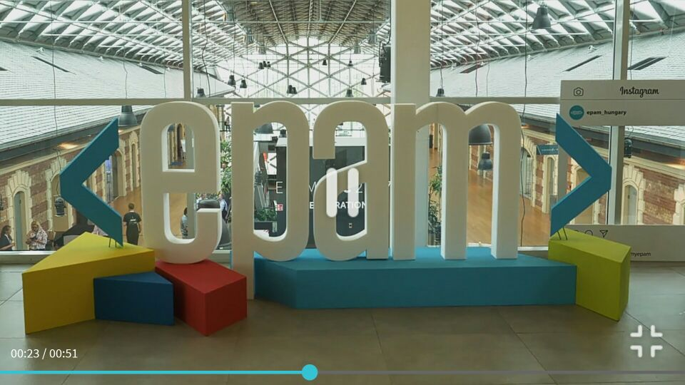
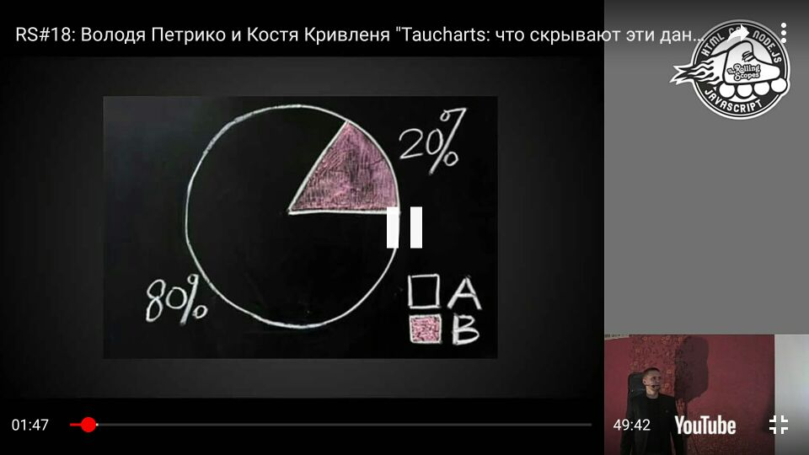
Video integration
One of the key features of any App is an opportunity to view the video content and YouTube. We needed:
Custom player design.
Fullscreen mode support.
“Autofullscreen” when rotating a device like in YouTube application

Slide 3
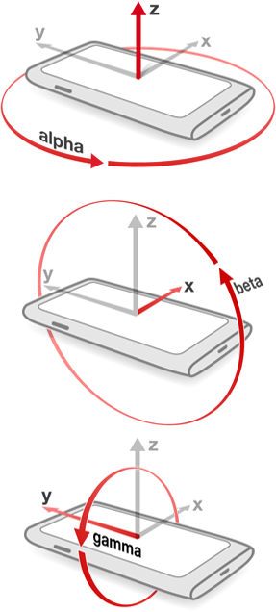
Creating native modules
To fulfill “autofullscreen” feature, we have implemented a native module which calculate the actual orientation of the device according to accelerometer data (pitch, roll, azimuth).
It allowed us to trigger fullscreen at the right time without unlocking the application layout.
As a result, we have got smooth and fast animations of fullscreen transitions.

